Slide 1
大数据
大数据系统基础（自主模式）- 清华大学 - 王建民、徐葳、陈康等
http://www.xuetangx.com/courses/course-v1:TsinghuaX+64100033X+SP/about

Slide 2
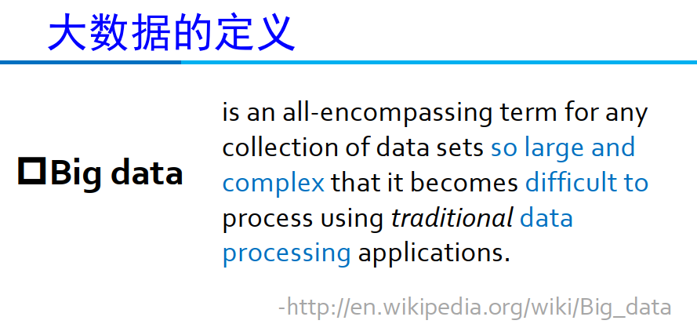

Slide 3
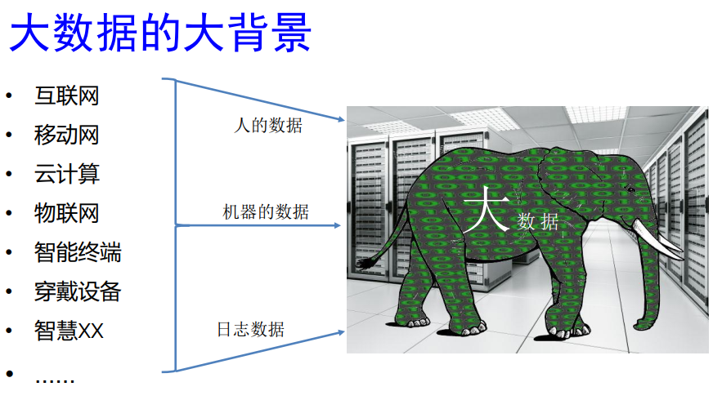

Slide 4

大数据平台核心技术（自主模式）-清华大学-武永卫、程永（永初）、姚文辉等
http://www.xuetangx.com/courses/course-v1:TsinghuaX+60240202X+sp/about
阿里云的这群疯子
https://www.huxiu.com/article/267100.html

Slide 5


Slide 6


Slide 7
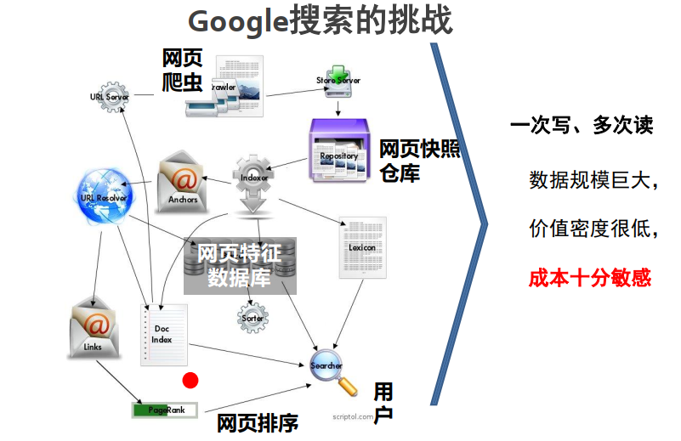

Slide 8
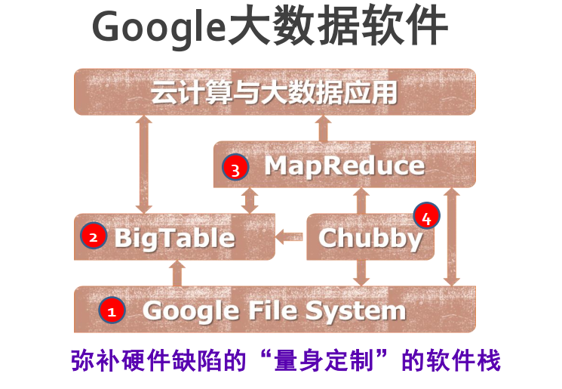

Slide 9
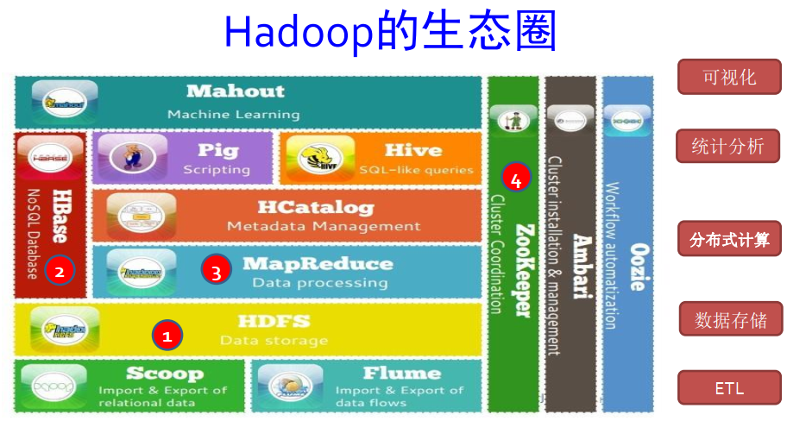

Slide 10
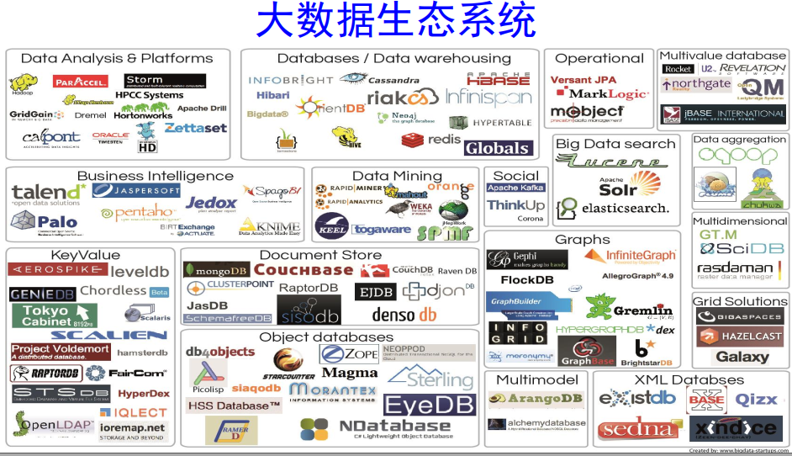

Slide 11

MapReduce
Mining of Massive Datasets
Jure Leskovec, Anand Rajaraman, Jeff Ullman Stanford University
http://www.mmds.org

Slide 12
MapReduce
Much of the course will be devoted to large scale computing for data mining
Challenges:
How to distribute computation?
Distributed/parallel programming is hard
Map-reduce addresses all of the above
Google’s computational/data manipulation model
Elegant way to work with big data

Slide 13
Single Node Architecture
CPU
Machine Learning, Statistics
Memory
“Classical” Data Mining
Disk

Slide 14
Motivation: Google Example
20+ billion web pages x 20KB = 400+ TB
1 computer reads 30-35 MB/sec from disk
~4 months to read the web
~1,000 hard drives to store the web
Takes even more to do something useful with the data!
Today, a standard architecture for such problems is emerging:
Cluster of commodity Linux nodes
Commodity network (ethernet) to connect them
Notes:
commodity英 [kəˈmɒdəti] 美 [kəˈmɑ:dəti] n.商品;日用品;有价值的物品;有利，有益

Slide 15
Cluster Architecture
2-10 Gbps backbone between racks
1 Gbps between
any pair of nodes
in a rack
Switch
Switch
Switch
CPU
CPU
CPU
CPU
Mem
…
Mem
Mem
…
Mem
Disk
Disk
Disk
Disk
Each rack contains 16-64 nodes
In 2011 it was guestimated that Google had 1M machines, http://bit.ly/Shh0RO
Notes:
rack英 [ræk] 美 [ræk] n.支架;行李架;刑架;（羊、猪等带前肋的）颈脊vt.使痛苦，使焦虑;剥削，榨取;用刑拘折磨

Slide 16
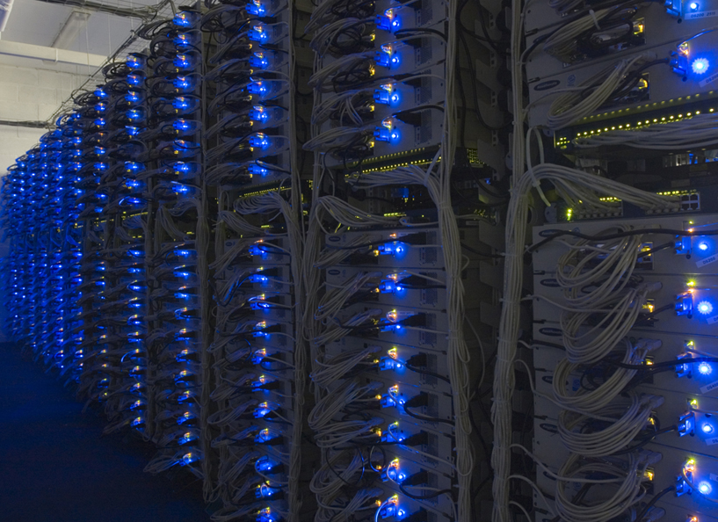

Slide 17
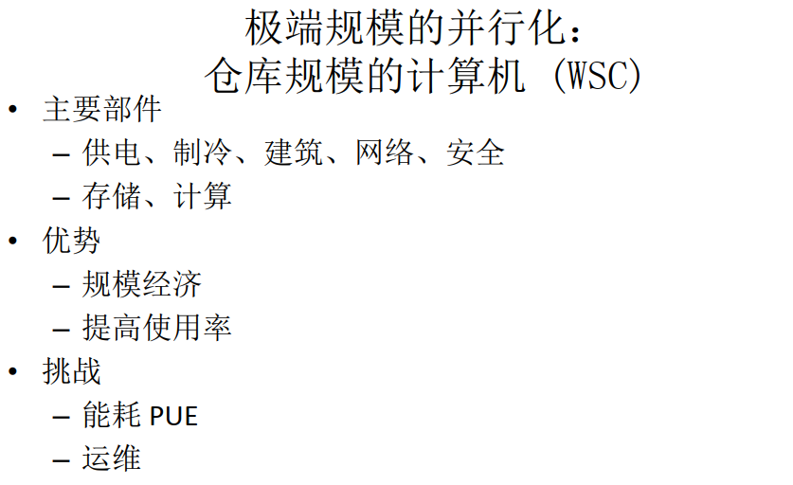

Slide 18
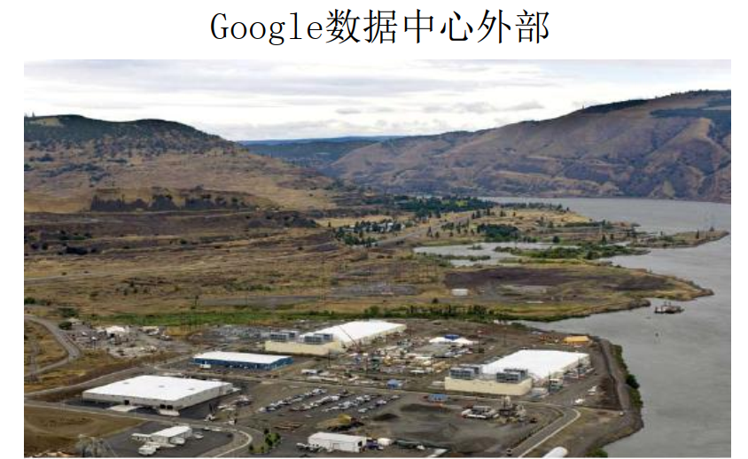

Slide 19
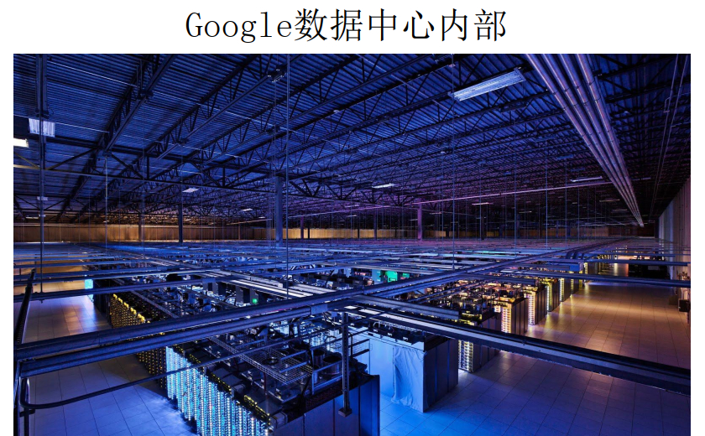

Slide 20


Slide 21


Slide 22
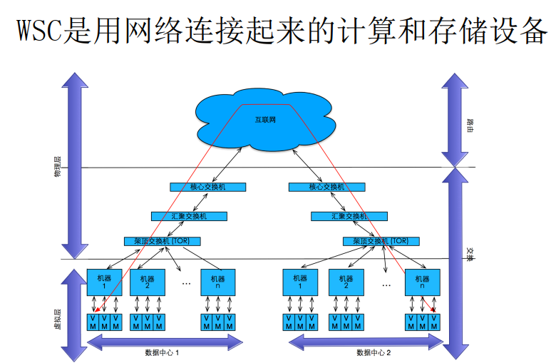

Slide 23
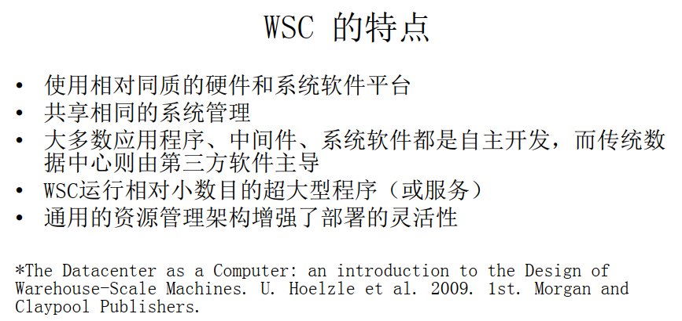

Slide 24


Slide 25
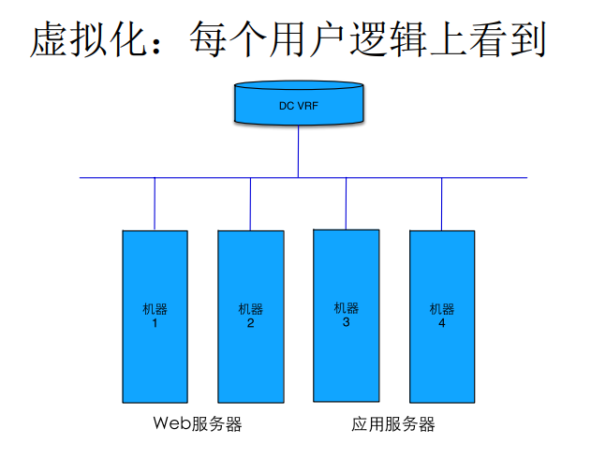

Slide 26
Large-scale Computing
Large-scale computing for data mining problems on commodity hardware
Challenges:
How do you distribute computation?
How can we make it easy to write distributed programs?
Machines fail:
One server may stay up 3 years (1,000 days)
If you have 1,000 servers, expect to loose 1/day
People estimated Google had ~1M machines in 2011
1,000 machines fail every day!

Slide 27
Idea and Solution
Issue: Copying data over a network takes time
Idea:
Bring computation close to the data
Store files multiple times for reliability
Map-reduce addresses these problems
Google’s computational/data manipulation model
Elegant way to work with big data
Storage Infrastructure – File system
Google: GFS. Hadoop: HDFS
Programming model
Map-Reduce

Slide 28
Storage Infrastructure
Problem:
If nodes fail, how to store data persistently?
Answer:
Distributed File System:
Provides global file namespace
Google GFS; Hadoop HDFS;
Typical usage pattern
Huge files (100s of GB to TB)
Data is rarely updated in place
Reads and appends are common

Slide 29
Distributed File System
Chunk servers
File is split into contiguous chunks
Typically each chunk is 16-64MB
Each chunk replicated (usually 2x or 3x)
Try to keep replicas in different racks
Master node
a.k.a. Name Node in Hadoop’s HDFS
Stores metadata about where files are stored
Might be replicated
Client library for file access
Talks to master to find chunk servers
Connects directly to chunk servers to access data

Slide 30
Distributed File System
Reliable distributed file system
Data kept in “chunks” spread across machines
Each chunk replicated on different machines
Seamless recovery from disk or machine failure
C₀
C₁
D₀
C₁
C₂
C₅
C₀
C₅
…
C₅
Chunk server 1
C₂
C₅
Chunk server 2
C₃
D₀
Chunk server 3
D₁
D₀
Chunk server N
C₂
Bring computation directly to the data!
Chunk servers also serve as compute servers
Notes:
30
seamless英 [ˈsi:mləs] 美 [ˈsimlɪs] adj.无缝的;无漏洞的

Slide 31
数据并行
大数据系统基础（自主模式）- 清华大学 - 王建民、徐葳、陈康等
http://www.xuetangx.com/courses/course-v1:TsinghuaX+64100033X+SP/about

Slide 32
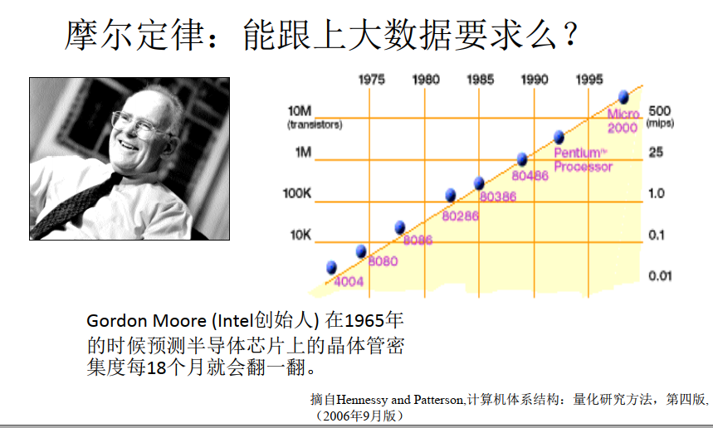

Slide 33
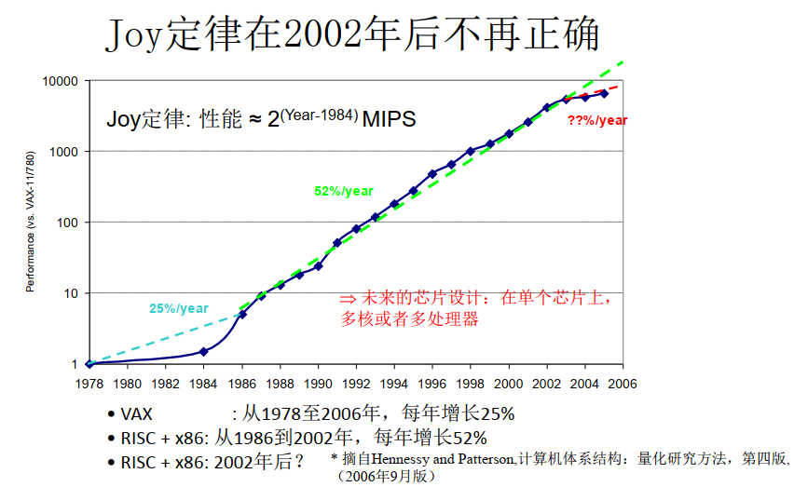
Notes:
处理器主频不能再提高，功耗与温度的限制。

Slide 34
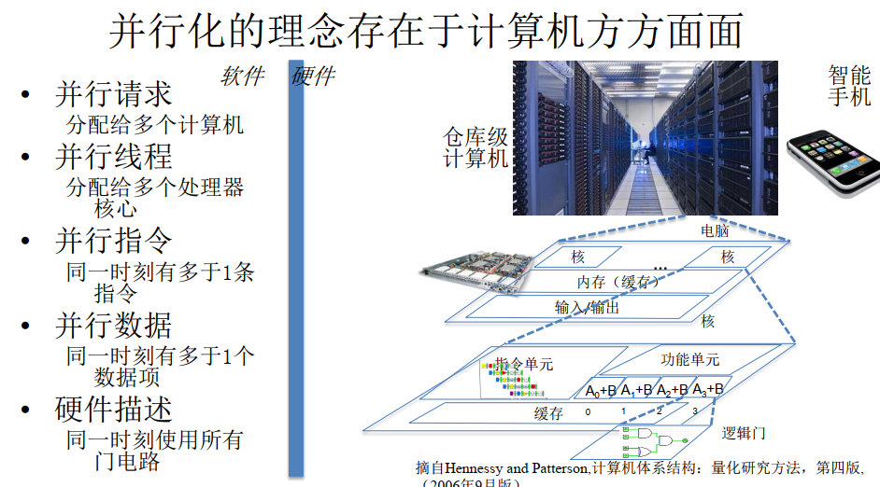

Slide 35
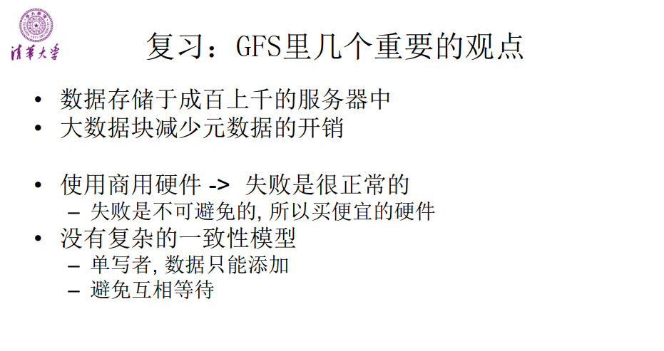

Slide 36
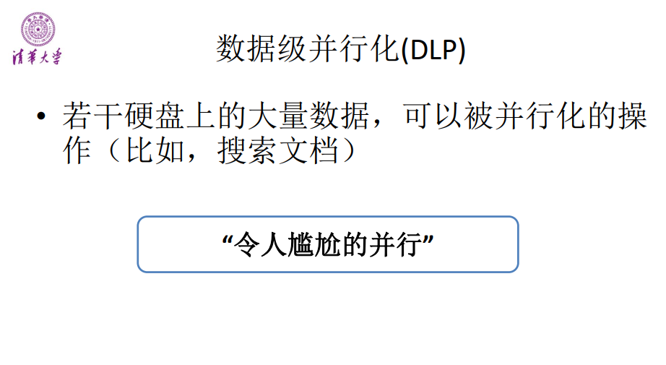

Slide 37
例子：搜索关键字的统计
Google是大家常用的搜索引擎，作为业务的重要特征，它自然想知道大家对哪些关键字感兴趣，比如以天为单位，收集所有人搜过的关键字，统计其出现的次数。
每天那么多人使用Google，它不可能把这些关键字都放在内存里，而且Google也是用很多服务器为大家完成搜索的，所以一天里所有搜过的关键字，都以文件的形式存在多台机器上。我们就叫这些机器1, 2, 3......n.

Slide 38
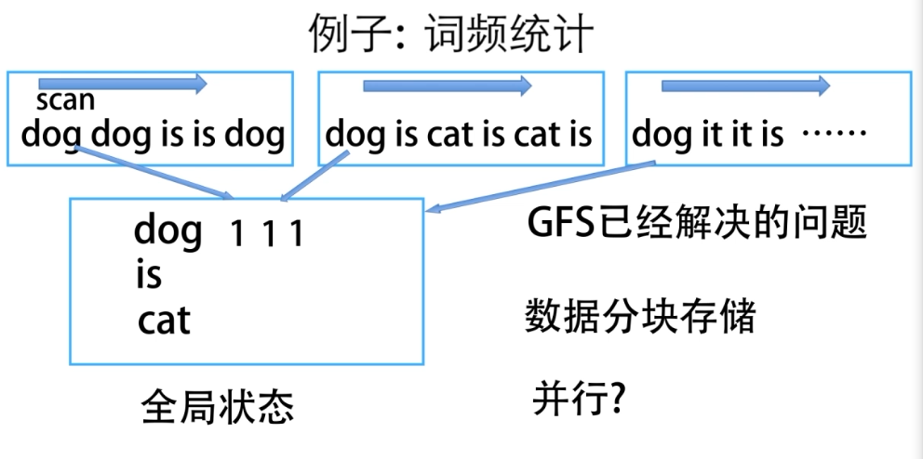

Slide 39
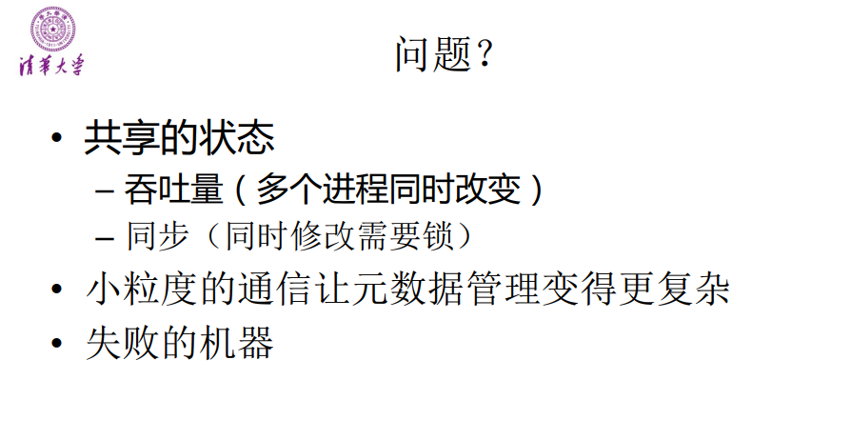

Slide 40
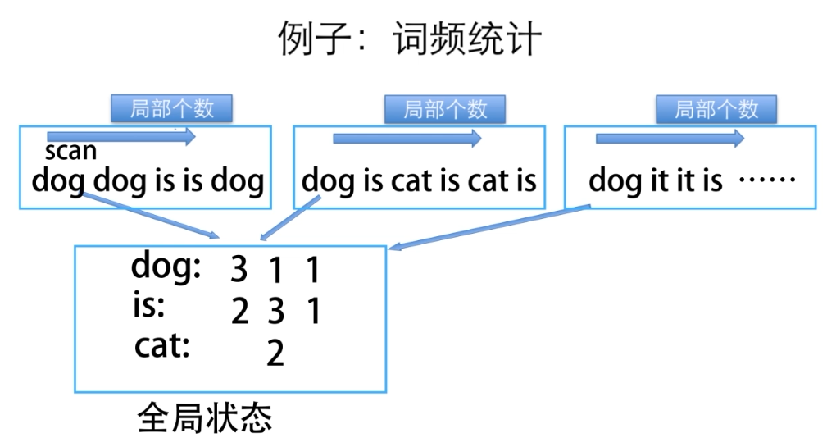

Slide 41
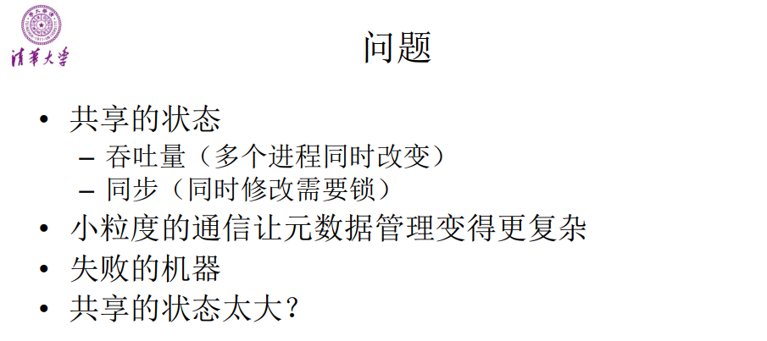

Slide 42
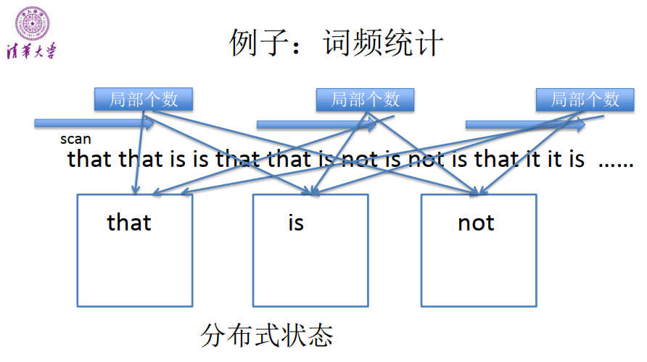

Slide 43
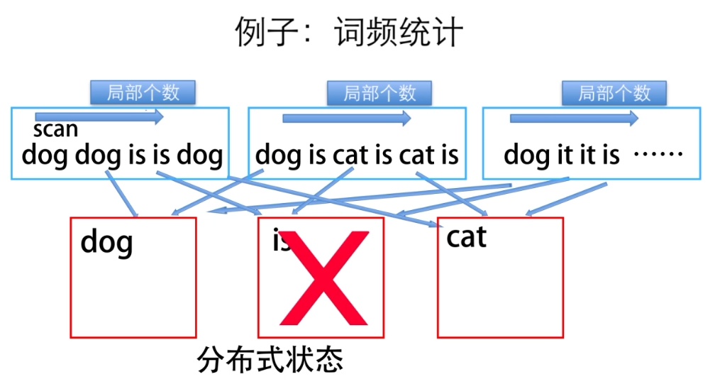

Slide 44
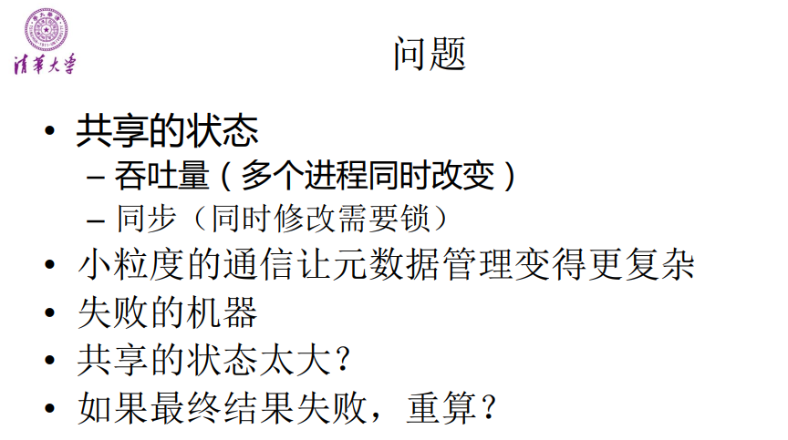

Slide 45
MapReduce
大数据系统基础（自主模式）- 清华大学 - 王建民、徐葳、陈康等
http://www.xuetangx.com/courses/course-v1:TsinghuaX+64100033X+SP/about

Slide 46
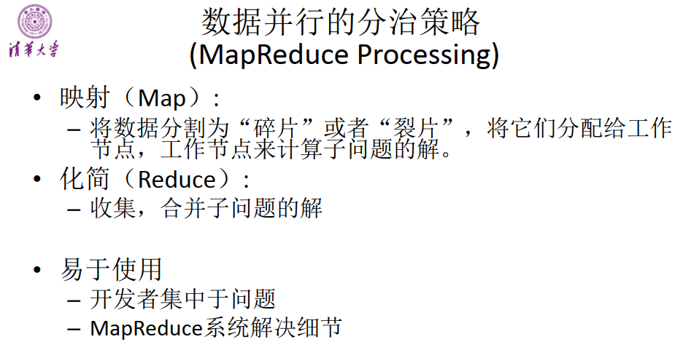

Slide 47
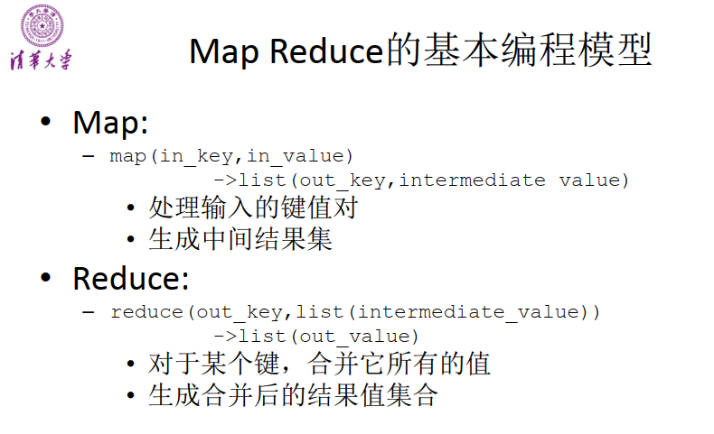

Slide 48
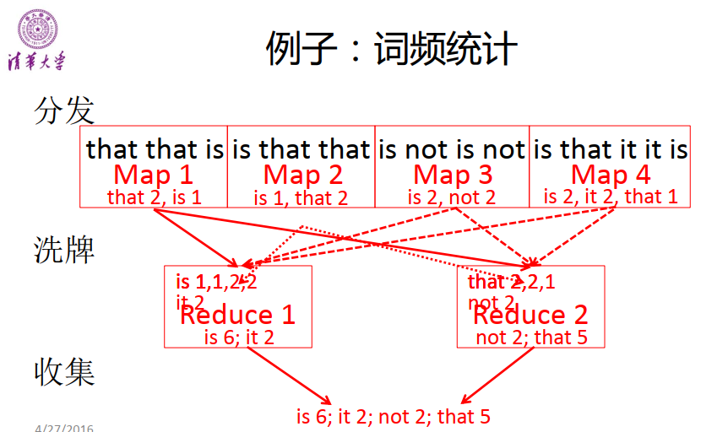

Slide 49
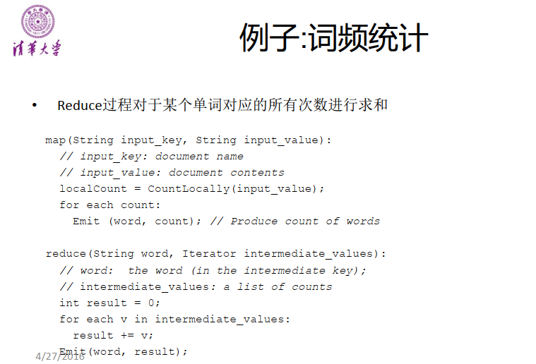

Slide 50
MapReduce
map
reduce
(k1,v1)
(k2,list(v2))
➔ list(k2,v2)
➔ list(v3)
输入的键和值，与输出的键和值相比，属 于不同的区域
中间结果中的键和值，与输出的键和值相 比，属于相同的区域
19

Slide 51
MapReduce的执行过程

Slide 52
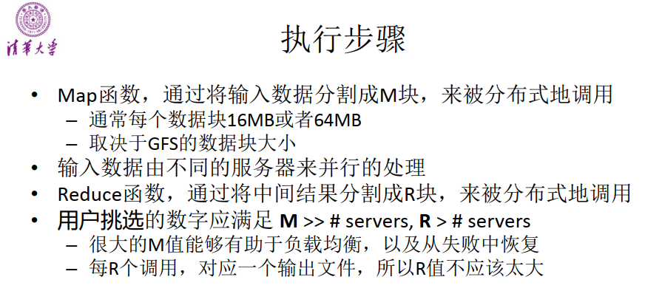

Slide 53
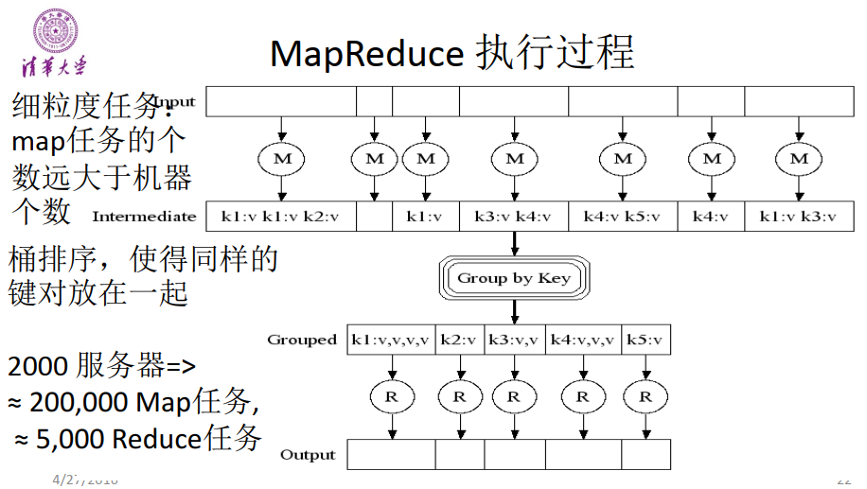

Slide 54
MapReduce: Word Counting
Provided by the programmer
Provided by the programmer
MAP:
Read input and produces a set of key-value pairs
Group by key:
Collect all pairs with same key
Reduce:
Collect all values belonging to the key and output
The crew of the space shuttle Endeavor recently returned to Earth as ambassadors, harbingers of a new era of space exploration. Scientists at NASA are saying that the recent assembly of the Dextre bot is the first step in a long-term space-based man/mache partnership. '"The work we're doing now -- the robotics we're doing -- is what we're going to need ……………………..
(The, 1)
(crew, 1)
(of, 1)
(the, 1)
(space, 1)
(shuttle, 1)
(Endeavor, 1)
(recently, 1)
….
(crew, 1)
(crew, 1)
(space, 1)
(the, 1)
(the, 1)
(the, 1)
(shuttle, 1)
(recently, 1)
…
(crew, 2)
(space, 1)
(the, 3)
(shuttle, 1)
(recently, 1)
…
Sequentially read the data
Only sequential reads
Big document
(key, value)
(key, value)
(key, value)

Slide 55
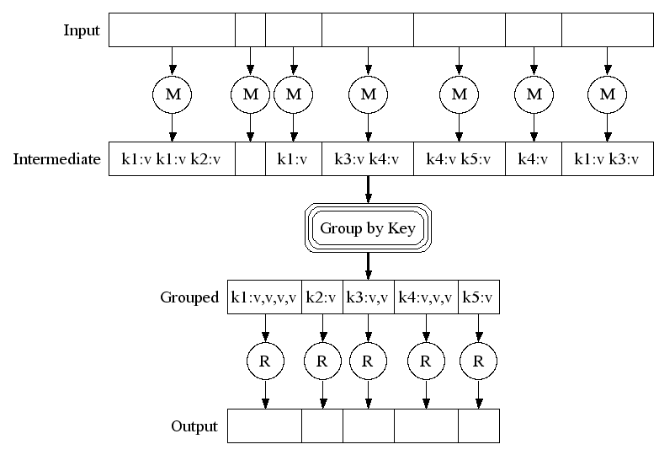
Map-Reduce: A diagram
Big document
MAP:
Read input and produces a set of key-value pairs
Group by key:
Collect all pairs with same key
(Hash merge, Shuffle, Sort, Partition)
Reduce:
Collect all values belonging to the key and output

Slide 56
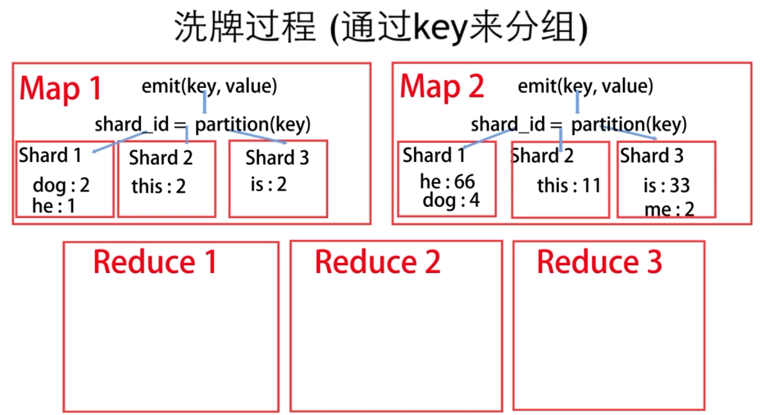
Notes:
shard英 [ʃɑ:d] 美 [ʃɑ:rd] n.（玻璃、金属或其他硬物的）尖利的碎片

Slide 57
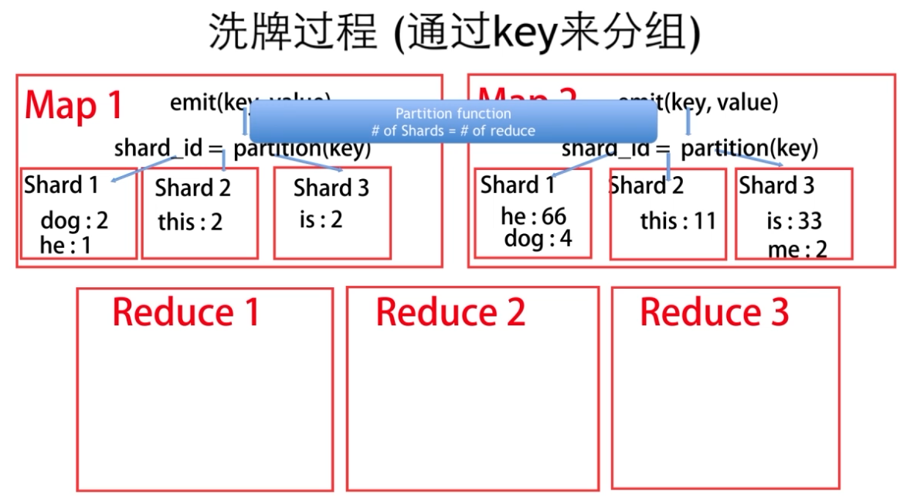

Slide 58
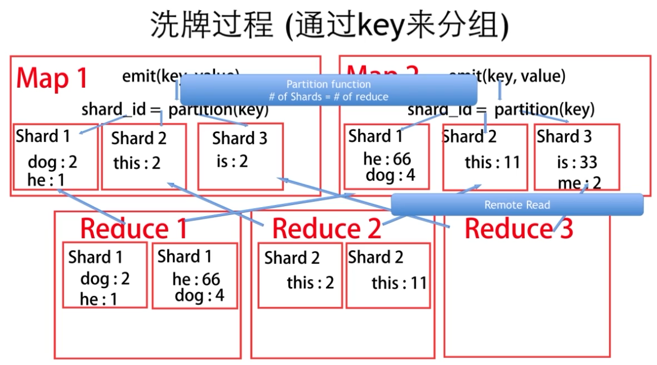

Slide 59
Problems Suited for Map-Reduce

Slide 60
Example: Host size
Suppose we have a large web corpus
Look at the metadata file
Lines of the form: (URL, size, date, …)
For each host, find the total number of bytes
That is, the sum of the page sizes for all URLs from that particular host
Map:
For each record, output (hostname(URL), size)
Reduce:
Sum the sizes for each host

Slide 61
Example: Language Model
Statistical machine translation:
Need to count number of times every 5-word sequence occurs in a large corpus of documents
Very easy with MapReduce:
Map:
Extract (5-word sequence, count) from document
Reduce:
Combine the counts

Slide 62
Example: Join By Map-Reduce
Compute the natural join R(A,B) ⋈ S(B,C)
R and S are each stored in files
Tuples are pairs (a,b) or (b,c)
A | B
a₁ | b₁
a₂ | b₁
a₃ | b₂
a₄ | b₃
B | C
b₂ | c₁
b₂ | c₂
b₃ | c₃
A | C
a₃ | c₁
a₃ | c₂
a₄ | c₃
⋈
=
S
R

Slide 63
Map-Reduce Join
Use a hash function h from B-values to 1...k
A Map process turns:
Each input tuple R(a,b) into key-value pair (b,(a,R))
Each input tuple S(b,c) into (b,(c,S))
Map processes send each key-value pair with key b to Reduce process h(b)
Hadoop does this automatically; just tell it what k is.
Each Reduce process matches all the pairs (b,(a,R)) with all (b,(c,S)) and outputs (a,b,c).

Slide 64
mrjob简介
助教：刘中坤

Slide 65
mrjob简介
mrjob is the easiest route to writing Python programs that run on Hadoop.
mrjob是一个编写MapReduce任务的开源Python框架，它实际上对Hadoop Streaming的命令行进行了封装，因此接触不到Hadoop的数据流命令行，使我们可以更轻松、快速的编写MapReduce任务。
Doc site: https://pythonhosted.org/mrjob/guides.html

Slide 66
Single-step jobs
mapper: A mapper takes a single key and value as input, and returns zero or more (key, value) pairs. The pairs from all map outputs of a single step are grouped by key.
combiner: A combiner takes a key and a subset of the values for that key as input and returns zero or more (key, value) pairs. Combiners are optimizations that run immediately after each mapper and can be used to decrease total data transfer.
reducer: A reducer takes a key and the complete set of values for that key in the current step, and returns zero or more arbitrary (key, value) pairs as output.
Notes:
单步job组成

Slide 67
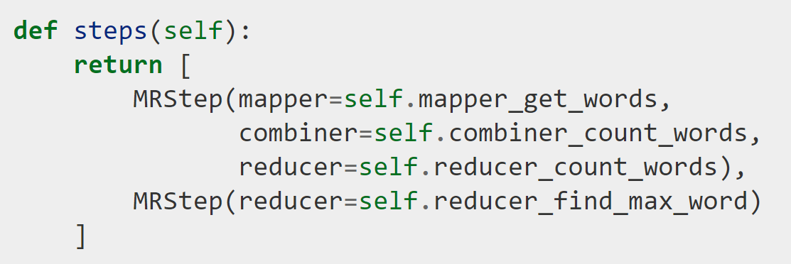
Multi-step jobs
To define multiple steps, override steps() to return a list of MRSteps.
Notes:
一个MRStep包含一个mapper combiner reducer

Slide 68
Protocol
mrjob assumes that all data is newline-delimited bytes. It automatically serializes and deserializes these bytes using protocols. Each job has an input protocol, an output protocol, and an internal protocol.
The input protocol is used to read the bytes sent to the first mapper (or reducer, if your first step doesn’t use a mapper). The output protocol is used to write the output of the last step to bytes written to the output file. The internal protocol converts the output of one step to the input of the next if the job has more than one step.

Slide 69
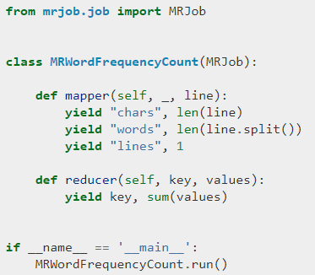
single-step job example

Slide 70
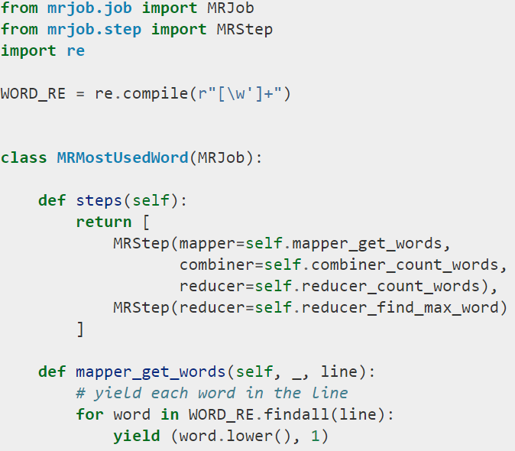
multi-step job example

Slide 71
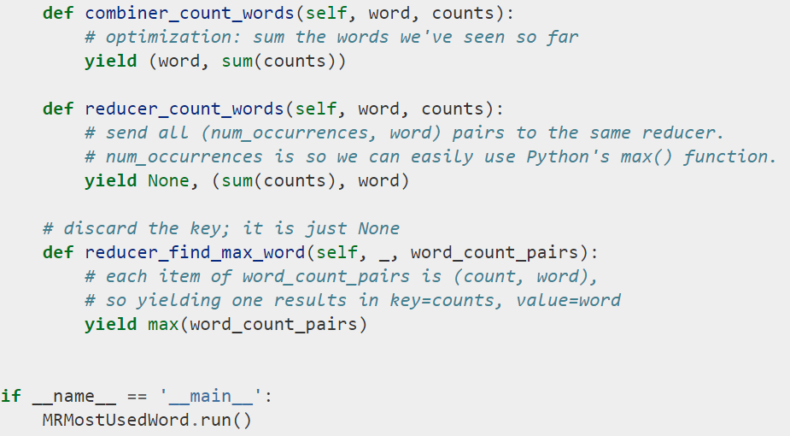
multi-step job example

Slide 72
Pointers and Further Reading

Slide 73
Implementations
Google
Not available outside Google
Hadoop
An open-source implementation in Java
Uses HDFS for stable storage
Download: http://lucene.apache.org/hadoop/
Aster Data
Cluster-optimized SQL Database that also implements MapReduce

Slide 74
Cloud Computing
Ability to rent computing by the hour
Additional services e.g., persistent storage
Amazon’s “Elastic Compute Cloud” (EC2)
Aster Data and Hadoop can both be run on EC2
For CS341 (offered next quarter) Amazon will provide free access for the class

Slide 75
Reading
Jeffrey Dean and Sanjay Ghemawat: MapReduce: Simplified Data Processing on Large Clusters
http://labs.google.com/papers/mapreduce.html
Sanjay Ghemawat, Howard Gobioff, and Shun-Tak Leung: The Google File System
http://labs.google.com/papers/gfs.html

Slide 76
Resources
Hadoop Wiki
Introduction
http://wiki.apache.org/lucene-hadoop/
Getting Started
http://wiki.apache.org/lucene-hadoop/GettingStartedWithHadoop
Map/Reduce Overview
http://wiki.apache.org/lucene-hadoop/HadoopMapReduce
http://wiki.apache.org/lucene-hadoop/HadoopMapRedClasses
Eclipse Environment
http://wiki.apache.org/lucene-hadoop/EclipseEnvironment
Javadoc
http://lucene.apache.org/hadoop/docs/api/

Slide 77
Resources
Releases from Apache download mirrors
http://www.apache.org/dyn/closer.cgi/lucene/hadoop/
Nightly builds of source
http://people.apache.org/dist/lucene/hadoop/nightly/
Source code from subversion
http://lucene.apache.org/hadoop/version_control.html

Slide 78
Further Reading
Programming model inspired by functional language primitives
Partitioning/shuffling similar to many large-scale sorting systems
NOW-Sort ['97]
Re-execution for fault tolerance
BAD-FS ['04] and TACC ['97]
Locality optimization has parallels with Active Disks/Diamond work
Active Disks ['01], Diamond ['04]
Backup tasks similar to Eager Scheduling in Charlotte system
Charlotte ['96]
Dynamic load balancing solves similar problem as River's distributed queues
River ['99]

